Slide 1

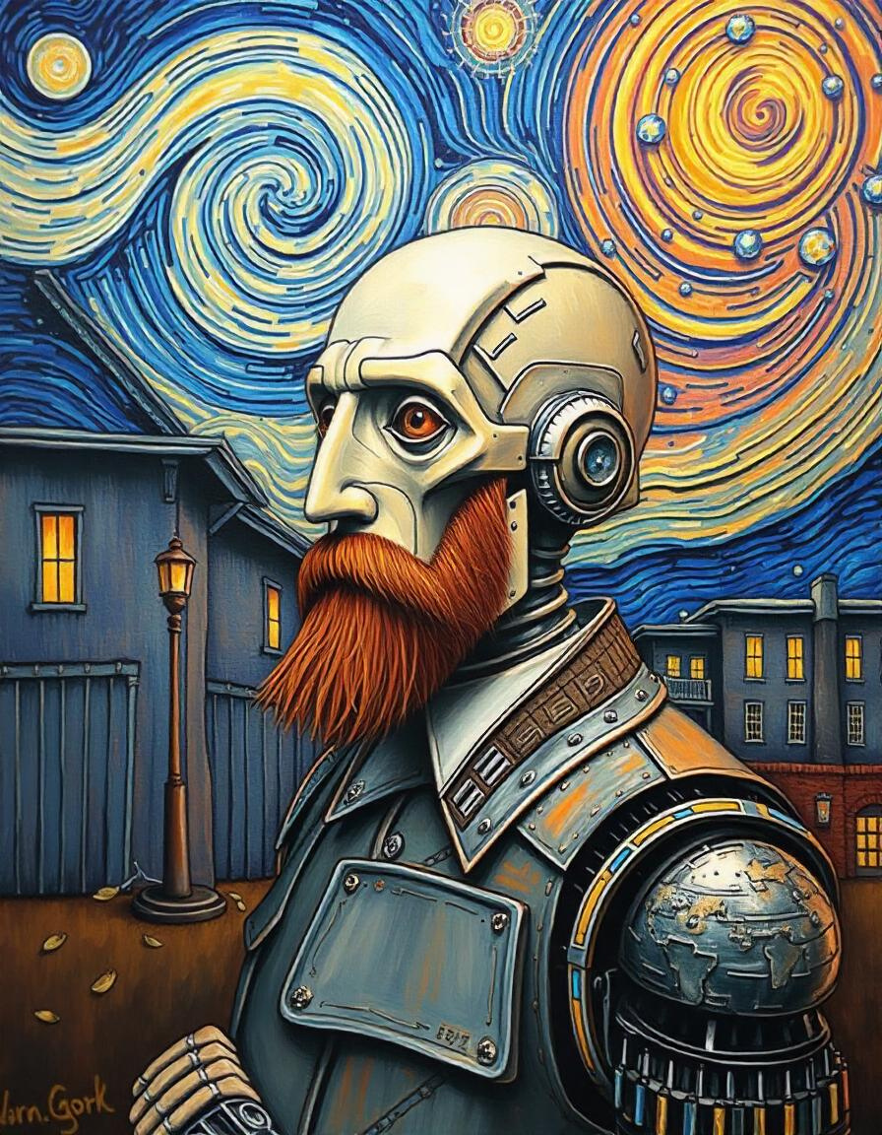
Artificial Vincent
Van Gogh
Our ideal goal is to create new and unique images of Christianity that embody Van Gogh's later style and expression.

Slide 2
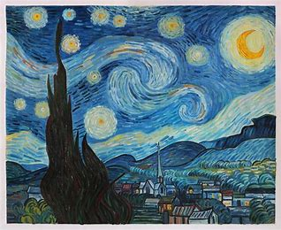
Who is Vincent
Van Gogh ?
Vincent Van Gogh (1853–1890) was a Dutch post-impressionist painter renowned for his vivid use of color and expressive brushwork. Despite struggling with mental illness and poverty during his lifetime, he produced around 2,100 artworks, including about 860 oil paintings, most of which were created in the last two years of his life.

Slide 3
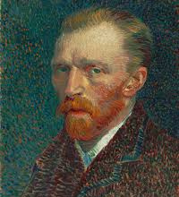
Project
Overview
Our project leverages the power of GANs & Neural Style
Transfer to analyze and learn from a comprehensive data set of Van Gogh's paintings. By training on this data, our model aims to generate new, unique Style images that
capture the essence of Van Gogh's post-
impressionist style, including his bold color choices,
expressive brushstrokes, and emotive compositions.

Slide 4
Project Steps
Data Collection
Data Preprocessing
This section outlines our data collection process. we collect fake & real data.
This section outlines our data collection process,
Building Model
Interface
Tdesigned to capture and reproduce the unique stylistic elements of Van Gogh's artwork.
an interface to interact with model in an
interactive way and display the results.

Slide 5
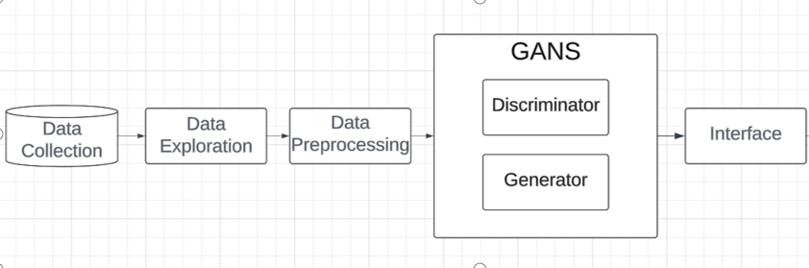
Project Pipeline

Slide 6
Data Collection
Van Gogh Museum
Amsterdam: Provided high-resolution images of their extensive collection.
Van Gogh Museum
Impressionist Classifier data
This comprises all the downloadable paintings from wikiart for all the above 10 artists (they were chosen based on having more than 500 paintings each in the WikiArt database).
impressionist classifier data
Van Gogh Paintings
Vincent Willem van Gogh was a Dutch post-Impressionist painter whose work had far-reaching influence on 20th-century art. His paintings include portraits, self portraits, landscapes, still lifes of cypresses, wheat fields and sunflowers.
Van Gogh paintings
VanGogh2Photo
The VanGogh2Photo dataset is designed to bridge the gap between artistic interpretations and real-world photography. It serves as a unique resource for researchers and developers working on image-to-image translation, style transfer, and other computer vision tasks.
VanGogh2Photo

Slide 7
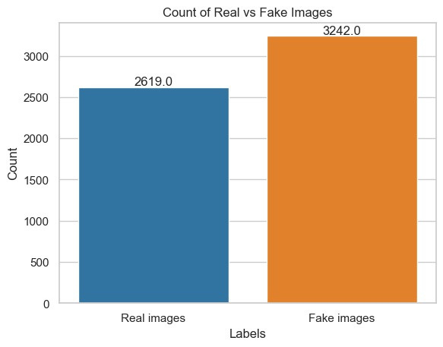
Our Data
This bar chart shows the distribution of real versus fake images in a dataset, with counts for each category. Here's a breakdown of the key elements and an exploration based on this data:
-Real Images: 3274
- train: 2,619
- test: 655
-Fake images: 3,242

Slide 8
Data Preprocessing
Segmentation
Resized all images to Converted
all images (64 x 64) to RGB format
padding where necessary.
Standrization
Augmentation
Normalization
make all the images’ pixels between 0 and 1 by dividing on 255

Slide 9

GAN Model
Our project utilizes a custom Generative Adversarial Network (GAN) architecture designed specifically to capture and reproduce the unique stylistic elements of Van Gogh's artwork. This section details the overall architecture and the specific designs of the generator and discriminator networks.
Generator Network Design
Discriminator Network Design
View More

Slide 10
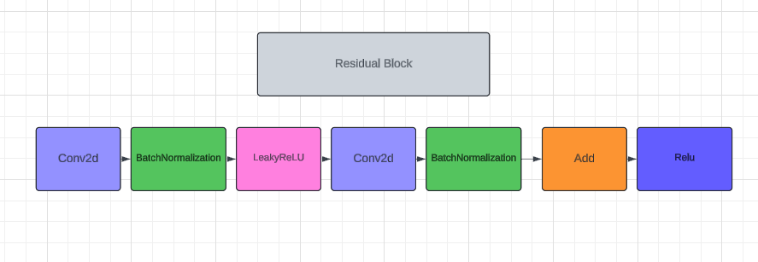
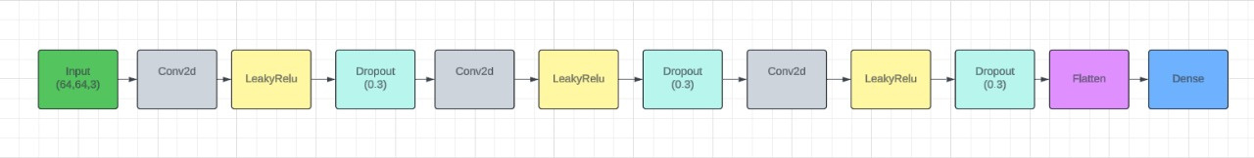
Generator
Discriminator

Slide 11
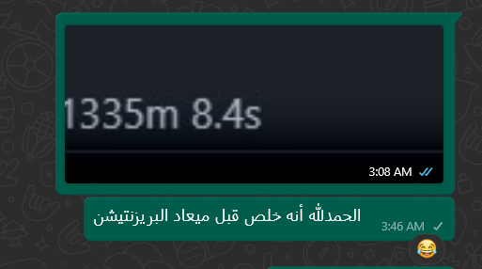
Training Process
Discriminator Training:
Train on a batch of real images (label: 1).
Train on pre-existing fake images (label: 0).
Generator Training:
Generate new images and train with labels as real (1.0), aiming to
fool the Discriminator.
Evaluation & Checkpointing:
Save Generated Images: Save sample images at regular intervals.
Model Checkpoints: Save model weights every 2000 epochs to allow resuming training.
Monitor Losses: Track Discriminator and Generator losses throughout the process.
Training Duration:
Train for 6100 epochs with a batch size of 64, allowing the model to improve over time.

Slide 12
Interface
we created an User interface (UI) for an application related to artificial style transfer & GANS based on Vincent Van Gogh's artwork to interact with our model that built-in Dash & Keras.

Slide 13
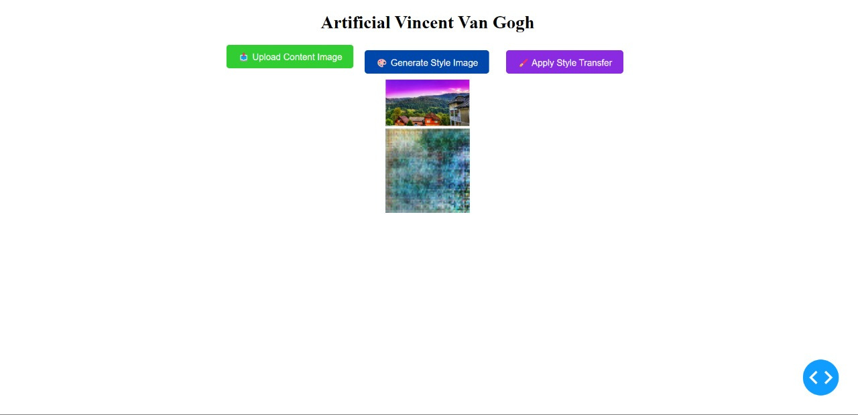
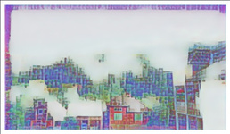
Interface

Slide 14
Team Members
Youssef Husseiny
Boules Ashraf
Abdallah Beshary
Shahd Alaa
Mariam Safwat
Mahmoud Ahmed

Slide 15
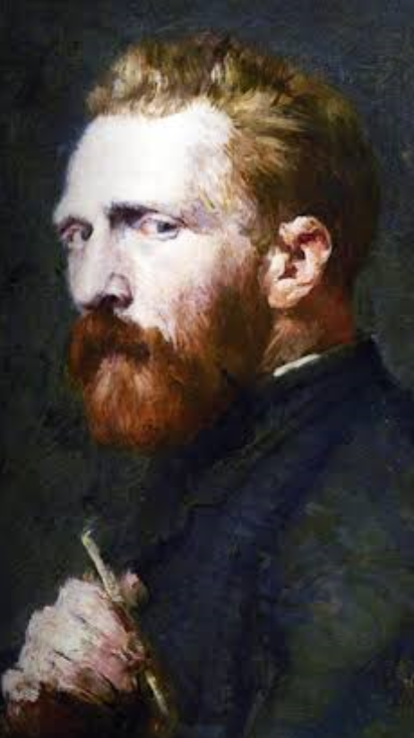
Quote
“What would life be
if we had no courage
to attempt anything ?”
Vincent Van Gogh

Slide 16
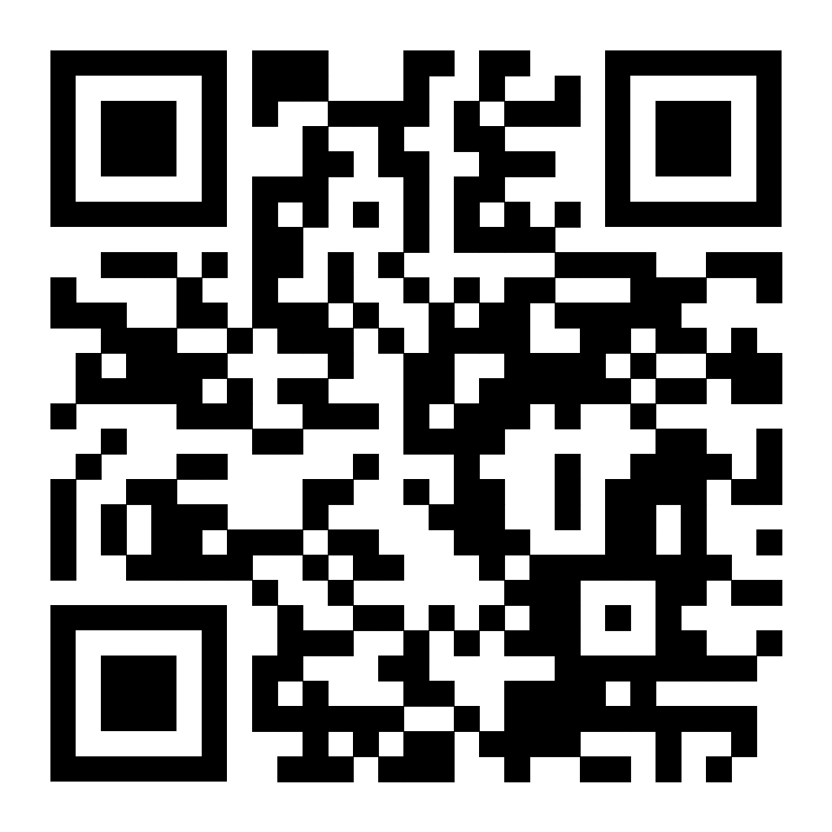
Artificial-Vincent-Van-Gogh repo

Slide 17
Thank You

